Slide 1
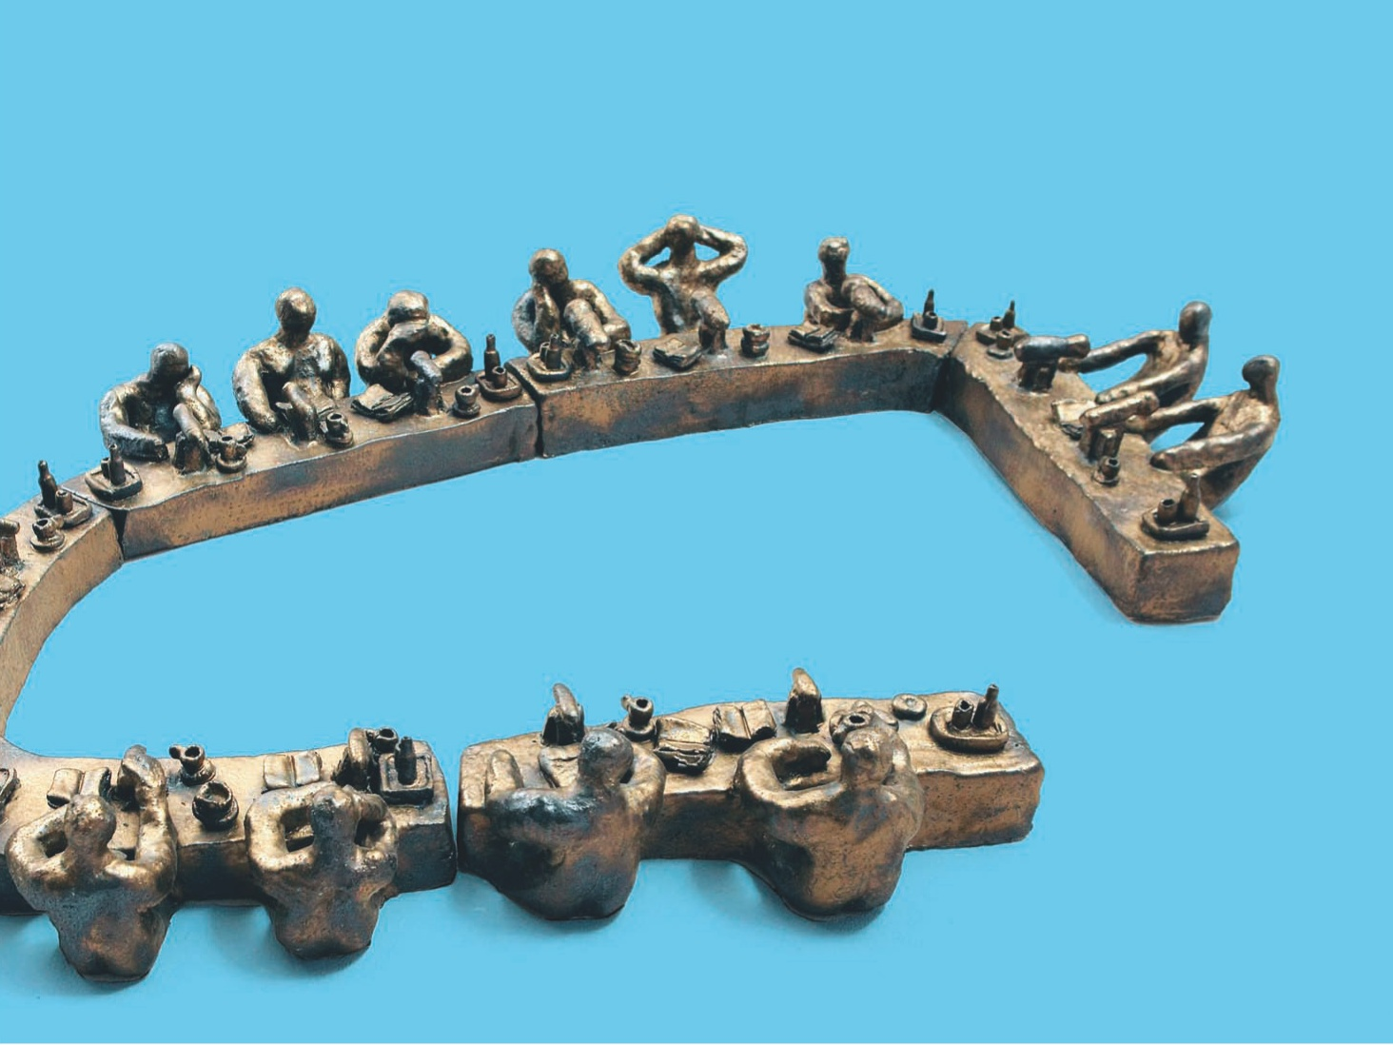

The Dutch consultation economy in perspective

Slide 2
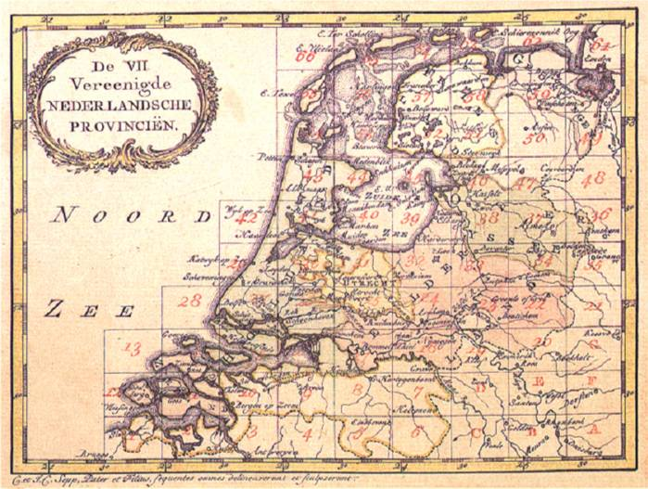
Holland: man-made land
Social dialogue finds its roots in a long tradition of consultation and cooperation
Step by step in 100 years much change
Netherlands now: top 5 best performing countries
Notes:
Consultation economy or social dialogue finds its roots in a long tradition of consultation and cooperation. Some see its origins in the way the Dutch joined forces to combat their common enemy, the sea, and to control water levels. Others point to the way in which the Dutch state was formed through negotiation around 1600.

Slide 3
Dutch consultation economy at three levels:
Company level: works councils
  Consultation: on important issues for the direction and future of the organisation
  Approval: on labour-related issues: working hours,
  health and safety, etc
Sector/company level: 500 collective labour agreements
  Cover 80% of employees
  Negotiation of wages and other benefits etc
National level:
  Labour Foundation
  Social and Economic Council
Notes:
In the Netherlands, agreements on social and economic policy are reached by consultation between different parties on different levels.
Within companies: employers and employees negotiate in works councils
At sector (or company) level: employers and employees negotiate on collective labour agreements, social funds, pension funds and training funds.
At national level: consultation takes place in the SER and in the Labour Foundation.

Slide 4
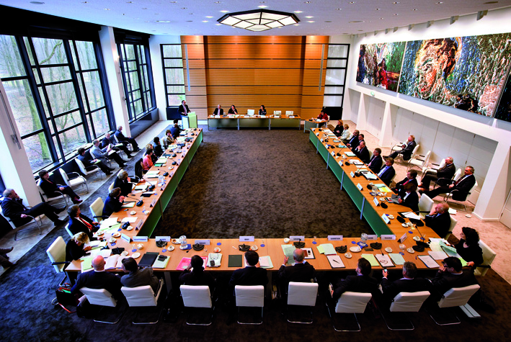
Social and Economic Council
Quick overview
Established 1950 by law
Advisory body to government
and parliament
Three groups, 33 members:
  employers (11)
  - employees /unions (11)
  - independent experts (11)
Secretariat of ca. 100 people;
policy advisors and facility staff
Financed via Chambers of
Commerce

Slide 5
What does the SER do?
Platform function, agendasetting: Organise debate, involve social partners & wider groups in relevant policy issues, sharing of insights
Advisory task: Advising government and parliament on the outlines of social and economic policy
Self regulation: coordination and implementation of common issues (e.g. consumersrights; code of conduct in mergers; international corporate social responsibility CSR)
Execution of specific laws: mainly where it directly relates to the social partners (e.g. work councils)
Notes:
The SER represents the interests of trade unions and industry, advising the government and parliament (upon request or at its own initiative) on all major social and economic issues.
The SER also has an administrative role. As the highest governing institution for the PBO sector, it supervises and monitors the commodity and industrial boards, which play an important part in the Dutch economy. Industrial boards are responsible for representing the interests of particular branches of industry, and are made up of employers’ representatives and union representatives.
In addition, the SER helps the government to enforce the Works Councils Act (Wet op de ondernemingsraden).
Advising government and parliament
Supervising commodity and industrial boards
Enforcing legislation such as in the context of the Works Council
Advising on introduction and discontinuation of boards and the periodical appointment of board managements
Coordinating joint activities for commodity and industrial boards, such as creating a Code of Good Governance

Slide 6
Shared view on goals
Mission statement
SER aims to help create social consensus on national and international socio-economic issues: creating common ground
Guiding principle: Broad concept of prosperity
Material progress (i.e., increased affluence and production)
Social progress (i.e., improved welfare and social cohesion)
High-quality environment in which to live (i.e., environmental
and spatial factors)
Three main objectives, explicitly formulated
Economic growth and sustainable development
The highest possible level of employment and participation
A fair distribution of income

Slide 7
Broad agenda
Some issues addressed in advisory projects:
Macro-economic state of the Netherlands
Innovation and productivity issues
Social security arrangements
Functioning of the labour market
Labour conditions, health & safety issues
Education, links to labour market
Employee participation
Health care system
European policies
Sustainable development/energy policies
….. Always from a socio-economic angle!

Slide 8
How does the SER work?
Advice: on request or at its own initiative
Preparation in committees (standing or ad hoc)
Common analysis of problems/issues, important groundwork
Involvement of ‘outsiders’, outreach to larger society
Consultation with rank-and-file
Public meetings of the council
Strive for unanimity, but advisory reports may be divided
Duration between 6 months – 1 year, speeding up

Slide 9
Impact, relation to government/politics
Politics in the Netherlands: coalitions always needed
Many parties, volatile in election outcomes
SER can foster stability by ‘creating common ground’
Best done by giving unanimous advice: have to deliver!
Then highly influential, no formal power
Advice is often followed up and implemented
Close relations with government/civil servants
‘Organic’ process, not dropping advice when finished
Pitfalls/criticism: undemocratic? Partial interests? Representative enough?

Slide 10

What are the conditions for success?
Social partners wanting to work together &
Political will and social acceptance to listen and seek advice
More process than structure!
respect for each others’ position
long-term orientation
(not just one-off deals)
create an environment of mutual trust
Invest in (personal) relations
stick to agreements, commitment to
longer-term agreements with other parties
→ Hard work, not easy! Only as good as the last advice

Slide 11
